Slide 1


BUS 240F · INFORMATION VISUALIZATION
Instructor: Prof. Yeabin Moon
POLICY SHOCK &
MOBILITY BEHAVIOR
Cecilia Pham
Youxuan Guan
Chieloka Mbaji

Slide 2


RESEARCH QUESTION
DID RECENT H-1B POLICY CHANGES AFFECT MOBILITY PATTERNS AROUND MAJOR TECH EMPLOYERS AND UNIVERSITIES IN THE BOSTON AREA?

Slide 3
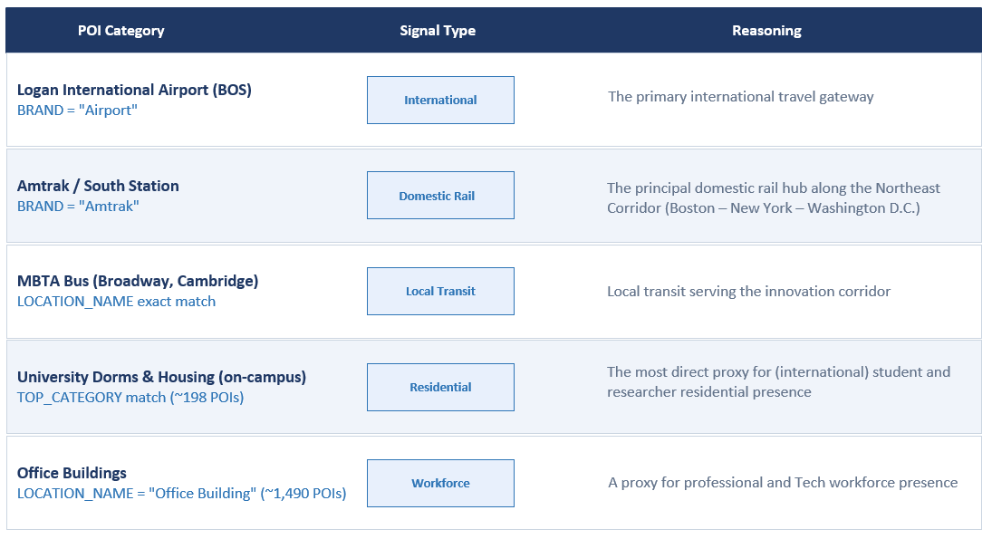
01
Description

Slide 4
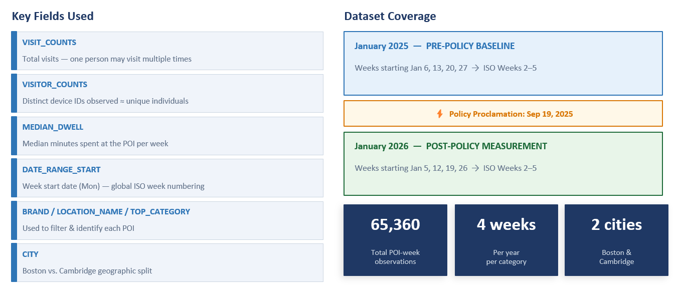
01
Description

Slide 5
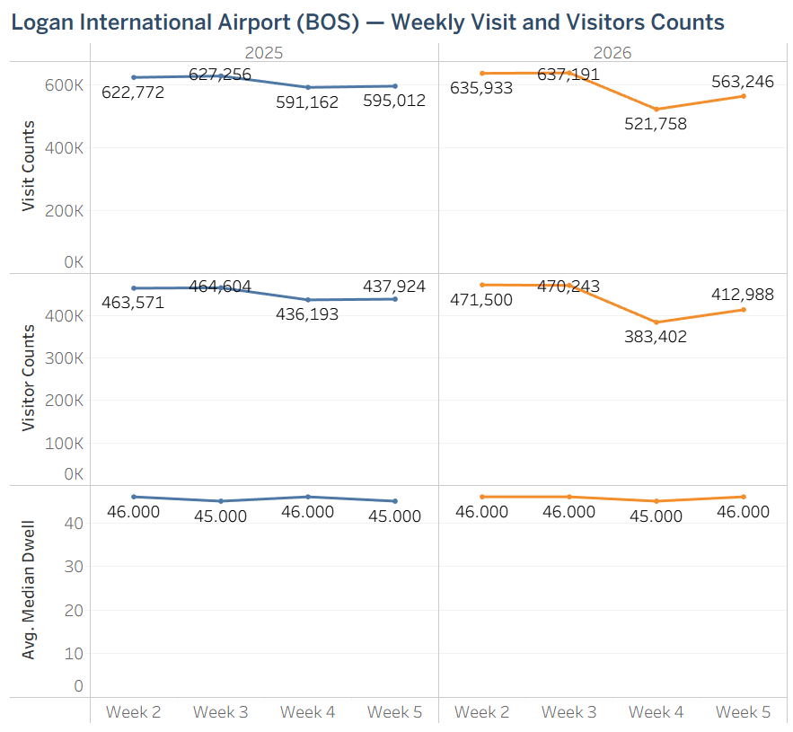
02
Logan International Airport (BOS)
  Overall monthly declines:
    Visits down
    Unique visitors down
  Dwell time ~ unchanged both year
  For the weekly changes, Weeks 1 and 2 have a slight boost in 2026. This likely due to pre booked trips.
  However in Weeks 3 and 4, we can see sharp declines of about -11.7% and -5.3%
3.2%
3.6%
Decline in traveler volume, while traveler behavior remained unchanged.

Slide 6
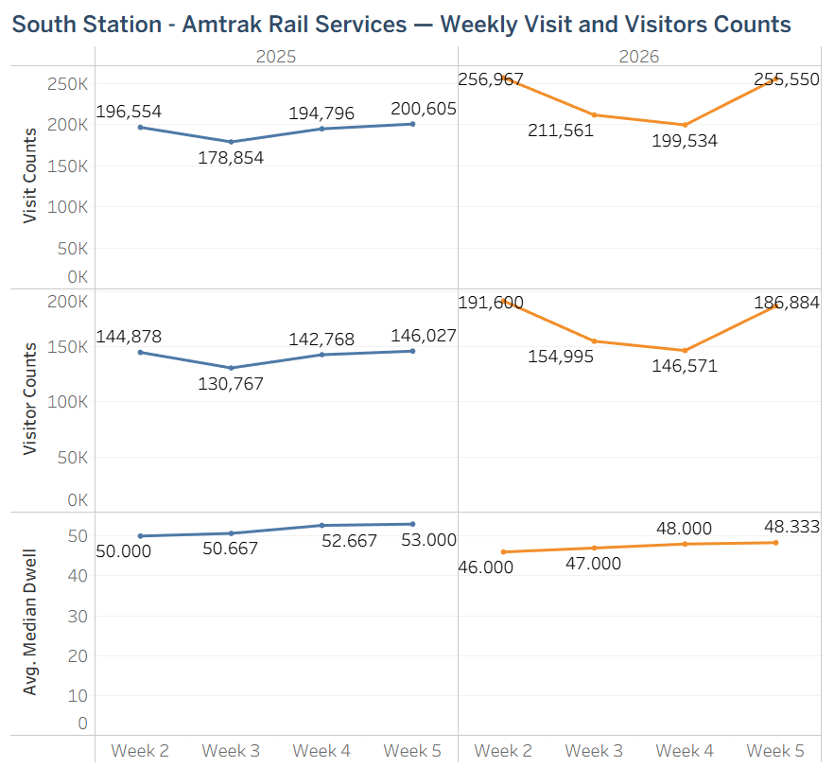
02
Amtrak / South Station
  Overall monthly increses:
    in visits
    in unique visitors
  All four weeks of January 2026 exceed January 2025
  Visits‑to‑visitors ratio remains stable
  Median dwell time decreased
  Here as well, we can see that 2026 has wild declines for the visit and visitor counts.
+ 19.8%
+20.5%
  A sustained month‑long uplift rather than a one‑week anomaly.
  The rail passenger base genuinely expanded.
  2026 riders were more purposeful and efficient

Slide 7
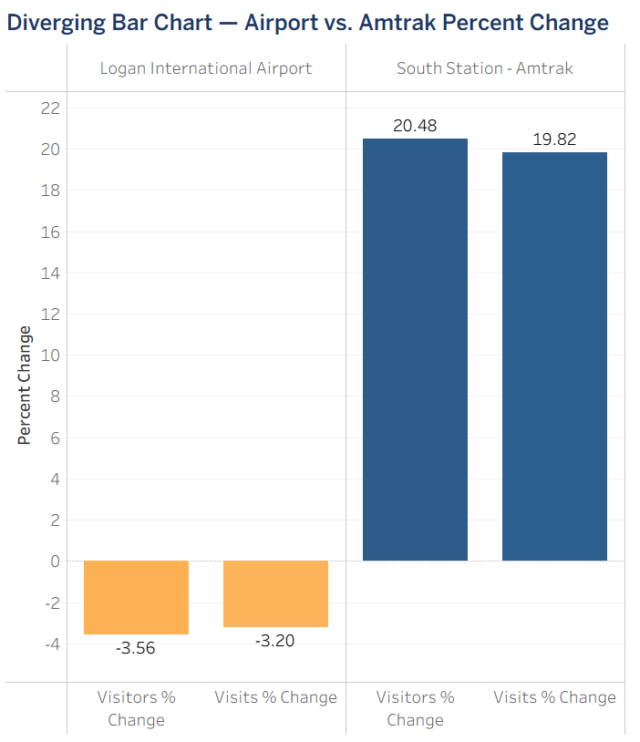
02
Comparison
A modal substitution:
Travelers shifting from international air to domestic rail
  Consistent with visa‑related uncertainty:
    Fewer international trips
    Domestic mobility maintained along the Northeast Corridor (Boston–NYC–DC)

Slide 8
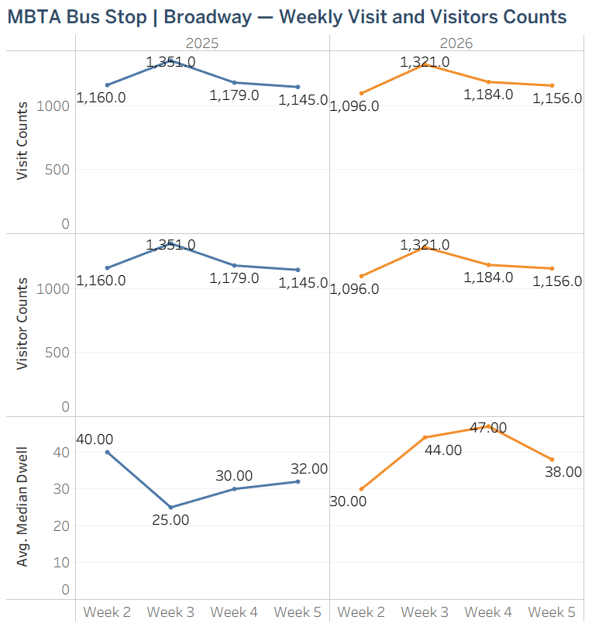
02
MBTA Bus Stop - Broadway, Cambridge
  Visit counts declined only
  Median dwell time increased by
    Plausible explanations:
      Reduced service frequency or capacity constraints
      Shift in user mix, with different types of riders spending more time at the stop
1.6%
25.2%
  Daily commuters continued their routines despite broader travel shifts
  A key stabilizing signal → Prevents over‑interpreting BOS and Amtrak trends

Slide 9
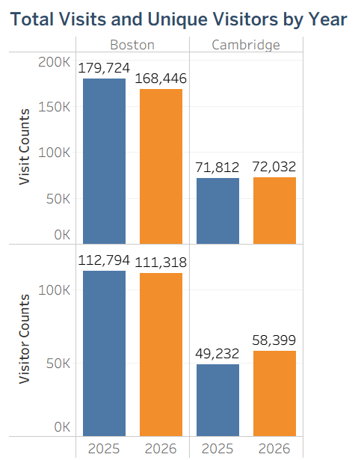
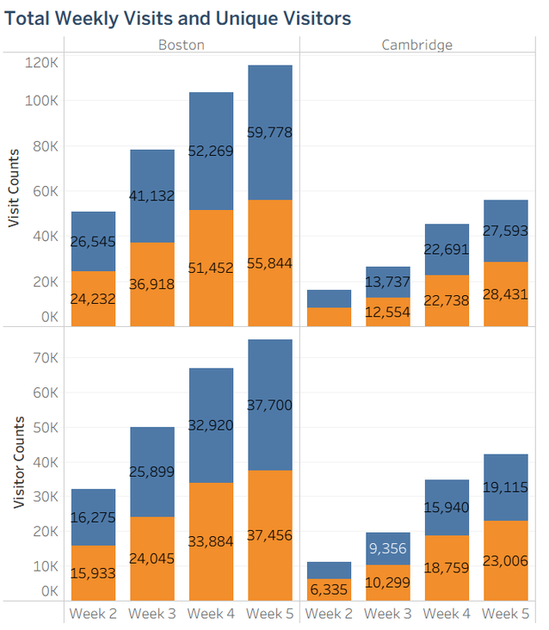
02
University dormitories and housing
-6.3%
  Seasonal patterns match across years
  A change in resident composition, rather than a straightforward increase in occupancy.
  Boston: in visit counts
  Cambridge: increased in unique visitors

Slide 10
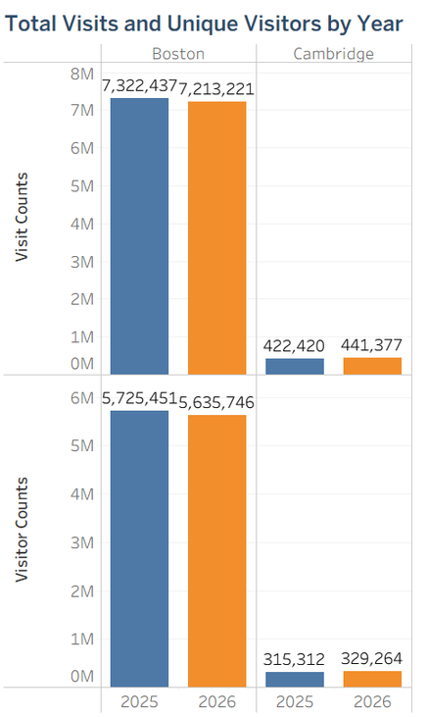
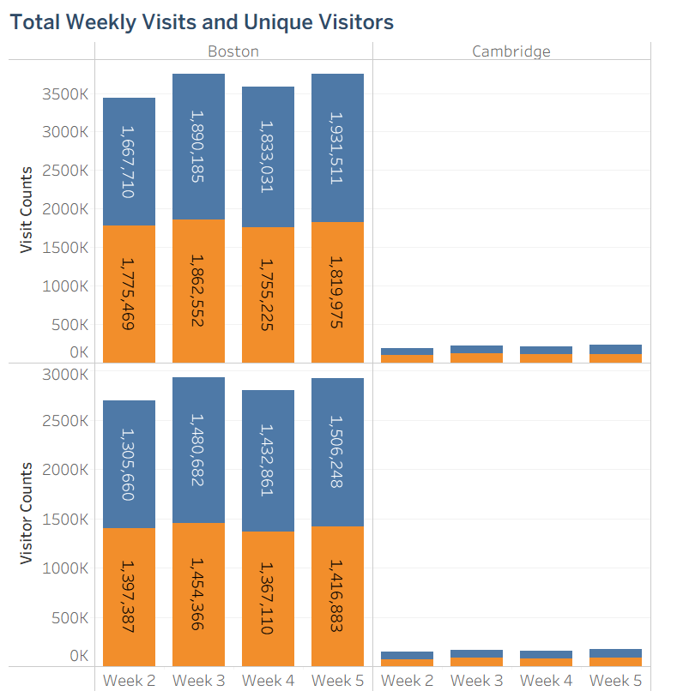
02
Office buildings (Boston and Cambridge)
-1.5%
  Boston: in visit counts
  Cambridge: in visit counts
No evidence of a tech‑workforce pullback
+4.5%

Slide 11
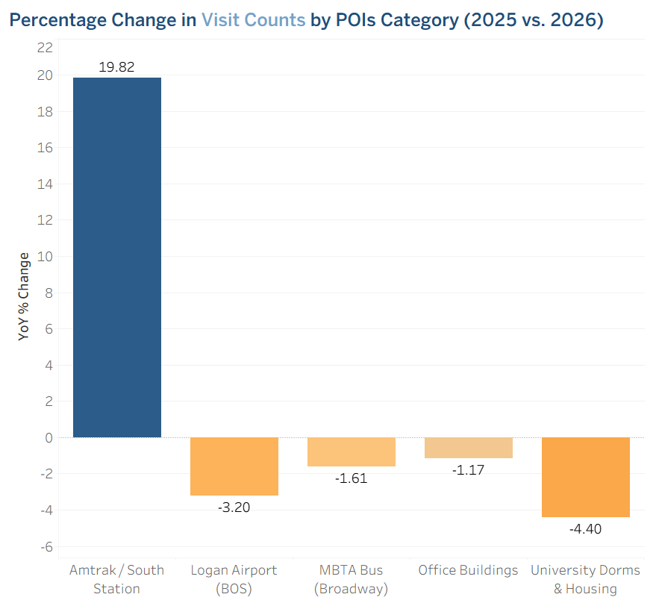
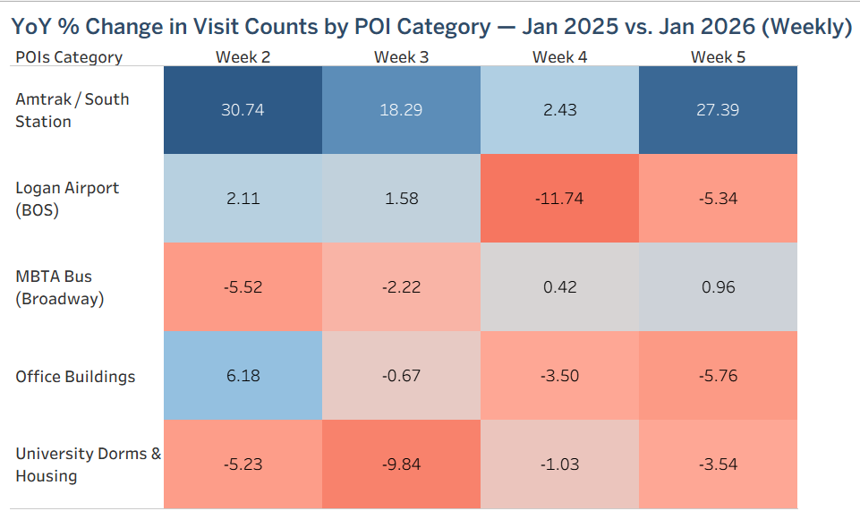


03
Conclusion
Overall, a “YES” for the research question
— selectively and moderately
  Weak‑to‑moderate evidence of a targeted mobility shift:
    International‑linked channels softened, domestic and routine mobility stayed stable or strengthened
⇒ Consistent with visa‑related uncertainty, but not definitive.

Slide 12
04
Limitations
GENERAL LIMITATIONS
POI-SPECIFIC LIMITATIONS
  Logan Airport — serves both domestic and international routes → cannot tell which type declined
  Amtrak — Northeast Corridor ridership was already rising due to national investment → hard to isolate policy effects.
  MBTA Bus — only one bus stop; the Red Line subway (Kendall → Central → Harvard) is the more representative H-1B commuter route but is not available in our data
  University dorms also include domestic students
  Office Buildings — with roughly 1,490 office POIs across all industries → H-1B tech workers make up only a small fraction of the total
  Only 2 months of data → cannot tell if the changes started before the policy or continued afterward.
  Cannot prove causation ~ other factors (economic, weather,...) could explain the same results.
  No comparison city ~ Without a comparable city → cannot separate policy effects from national trends

Slide 13
THANK YOU

